Slide 1
NE Washington Visitor Opportunities Study
Survey Results
2022

Slide 2
Survey Summary

Slide 3
Survey Dates
Survey Opened
February 6, 2022
Survey Closed
March 18, 2022
Online distribution via email lists and social media:
The survey link and information was sent out via email to the Tri County Economic Development District’s (TEDD) main contact list of over 900 email addresses.
Survey link posted to TEDD Facebook and Twitter feeds, as well as on our Visit Northeast Washington Facebook, Instagram and Twitter feeds.
A flyer with the QR code was displayed at the Visit Northeast Washington booth during the Spokane Great Outdoor and Bike Show.
Physical distribution of survey outreach cards at the following locations:
400 cards with the survey link and information were distributed across the tri-county area, primarily to lodging establishments where the cards could be left in guest rooms.
A flyer with the survey information and QR code were placed in plexiglass stands and distributed to 12 businesses, including 49 Degrees North Ski Resort, Stonerose Fossil Interpretive Center, among others.
Notes:
Joel Will do

Slide 4
Survey Response Rates
Total respondents: 475
Permanent Residents: 191
Temporary Residents: 45
Visitors: 234
Incomplete Surveys*: 12
Total completed surveys: 470
Notes and Caveats:
Survey asked visitors to NE Washington to describe responses for their most recent trip.
Results focus on responses from visitors.
Large proportion were users of the golf courses.
Responses from visitors used for all graphics.
*Approximately 57 percent of surveys were missing at least one response, but only 5 were not somewhat useable for our analysis

Slide 5
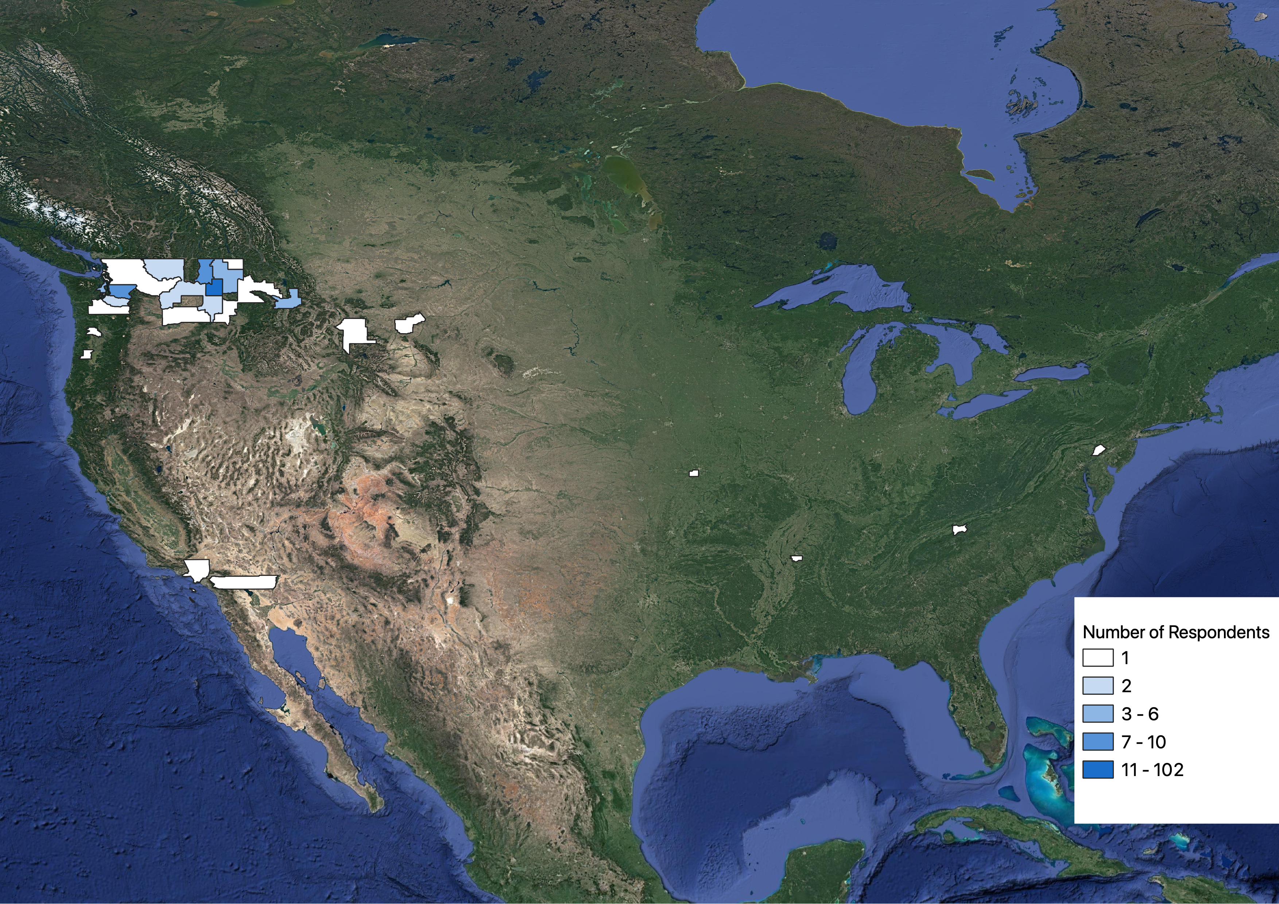
Where Did Respondents Visit From?
Note: Two respondents were from British Columbia, Canada

Slide 6
Survey Respondents by State/County
Total Responses by State/Region
Washington: 156
Idaho: 10
Montana: 7
Oregon and California: 4
Midwest: 1
South: 1
East: 1
Top 5 counties:
Spokane County (102)
King County (10)
Stevens County (9)
Pend Oreille County (6)
Bonner County (3)

Slide 7
Survey Results

Slide 8
Key Findings: Overall Summary
Visitors to Northeast Washington are somewhat satisfied with their experience, but we find key areas for improving visitor experiences and encouraging repeat visits.
Visitor profile: Visitors tend to be older, traveling with children not living at home, on multiday trips staying with friends/family or campground.
What visitors disliked: Lack of restaurants and accommodations, and lack of trail maintenance, political conditions were among main complaints from visitors.
Why would they choose not to return? Recreation, affordability, and natural beauty are among main reasons people would choose not to visit again.
Most popular activities: Golfing, restaurants, hiking, wildlife, camping, visiting friends, photography.
Most important factors for visiting: Scenic beauty, relaxation, and affordability were rated most important to visitors when deciding whether to visit.
What visitors liked: Scenery, affordability, and spending time with family were most common positive feedback from visitors.

Slide 9
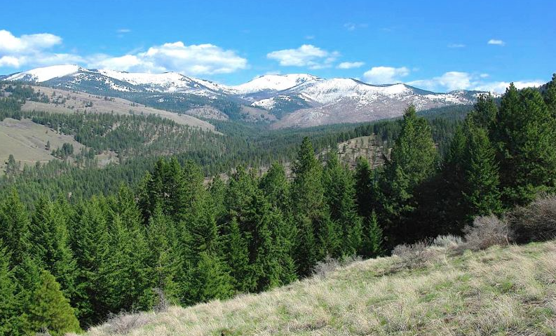
Section I: Visitor Overview

Slide 10
Visitor Overview
Average Group Size | 3.2
Average Number of Adults | 3.2
Average Number of Children | 2.7
Percent of Visitors Traveling with Children | 17%
Percent of Visitors on Overnight Trips | 48%
Average Length of Overnight Trips | 5.8 nights
Percent of Visitors on Day Trips | 52%

Slide 11
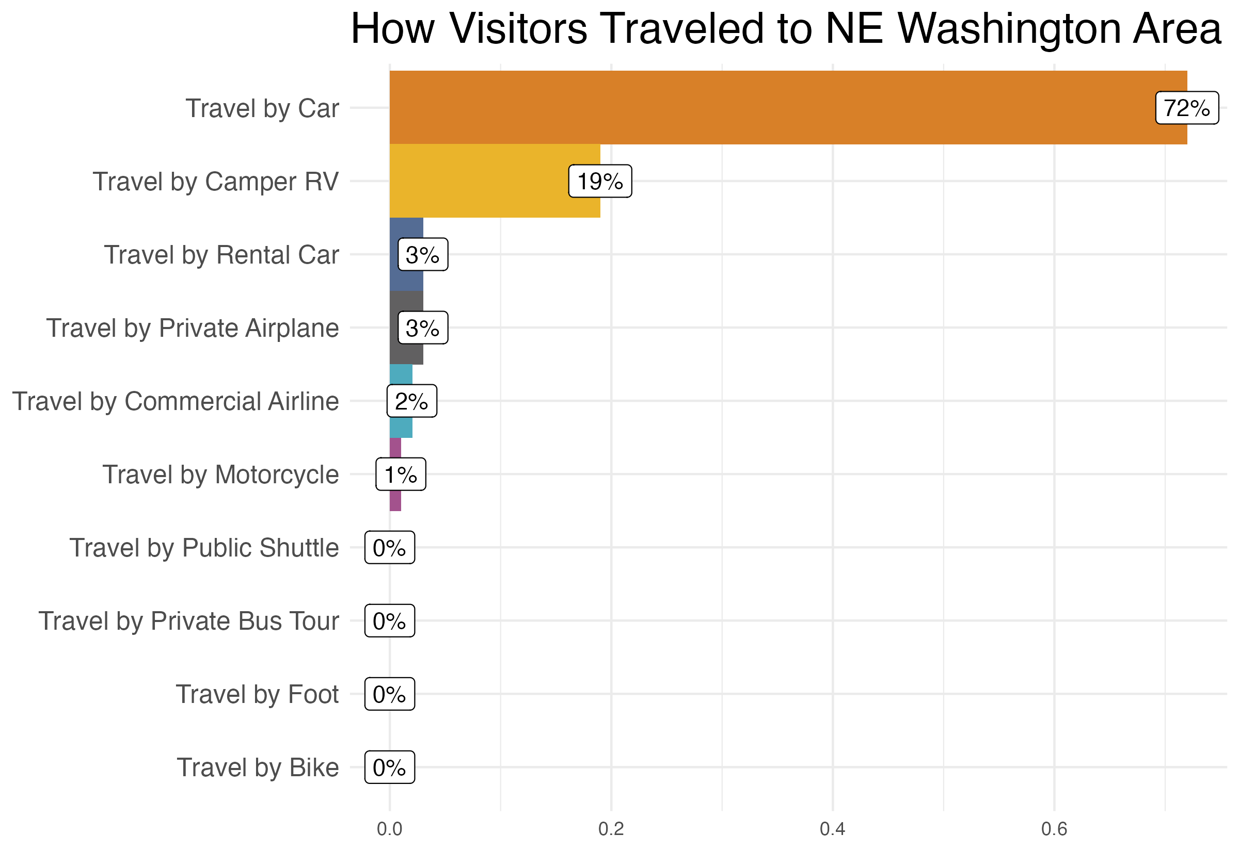
Visitor Overview

Slide 12
Visitor Overview

Slide 13
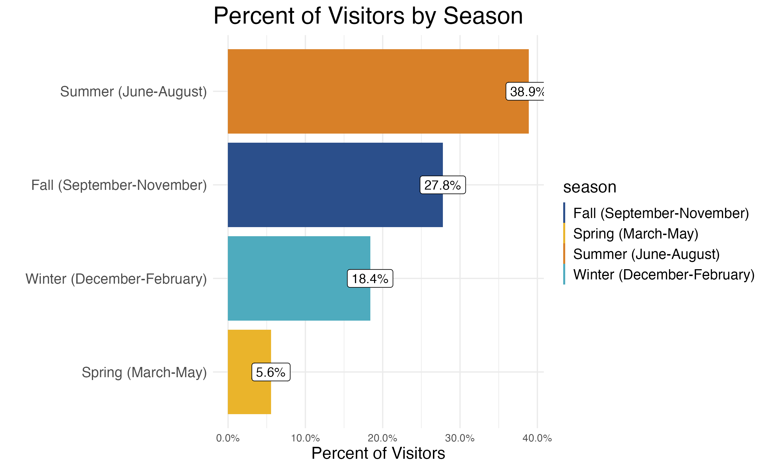
Visitor Overview

Slide 14
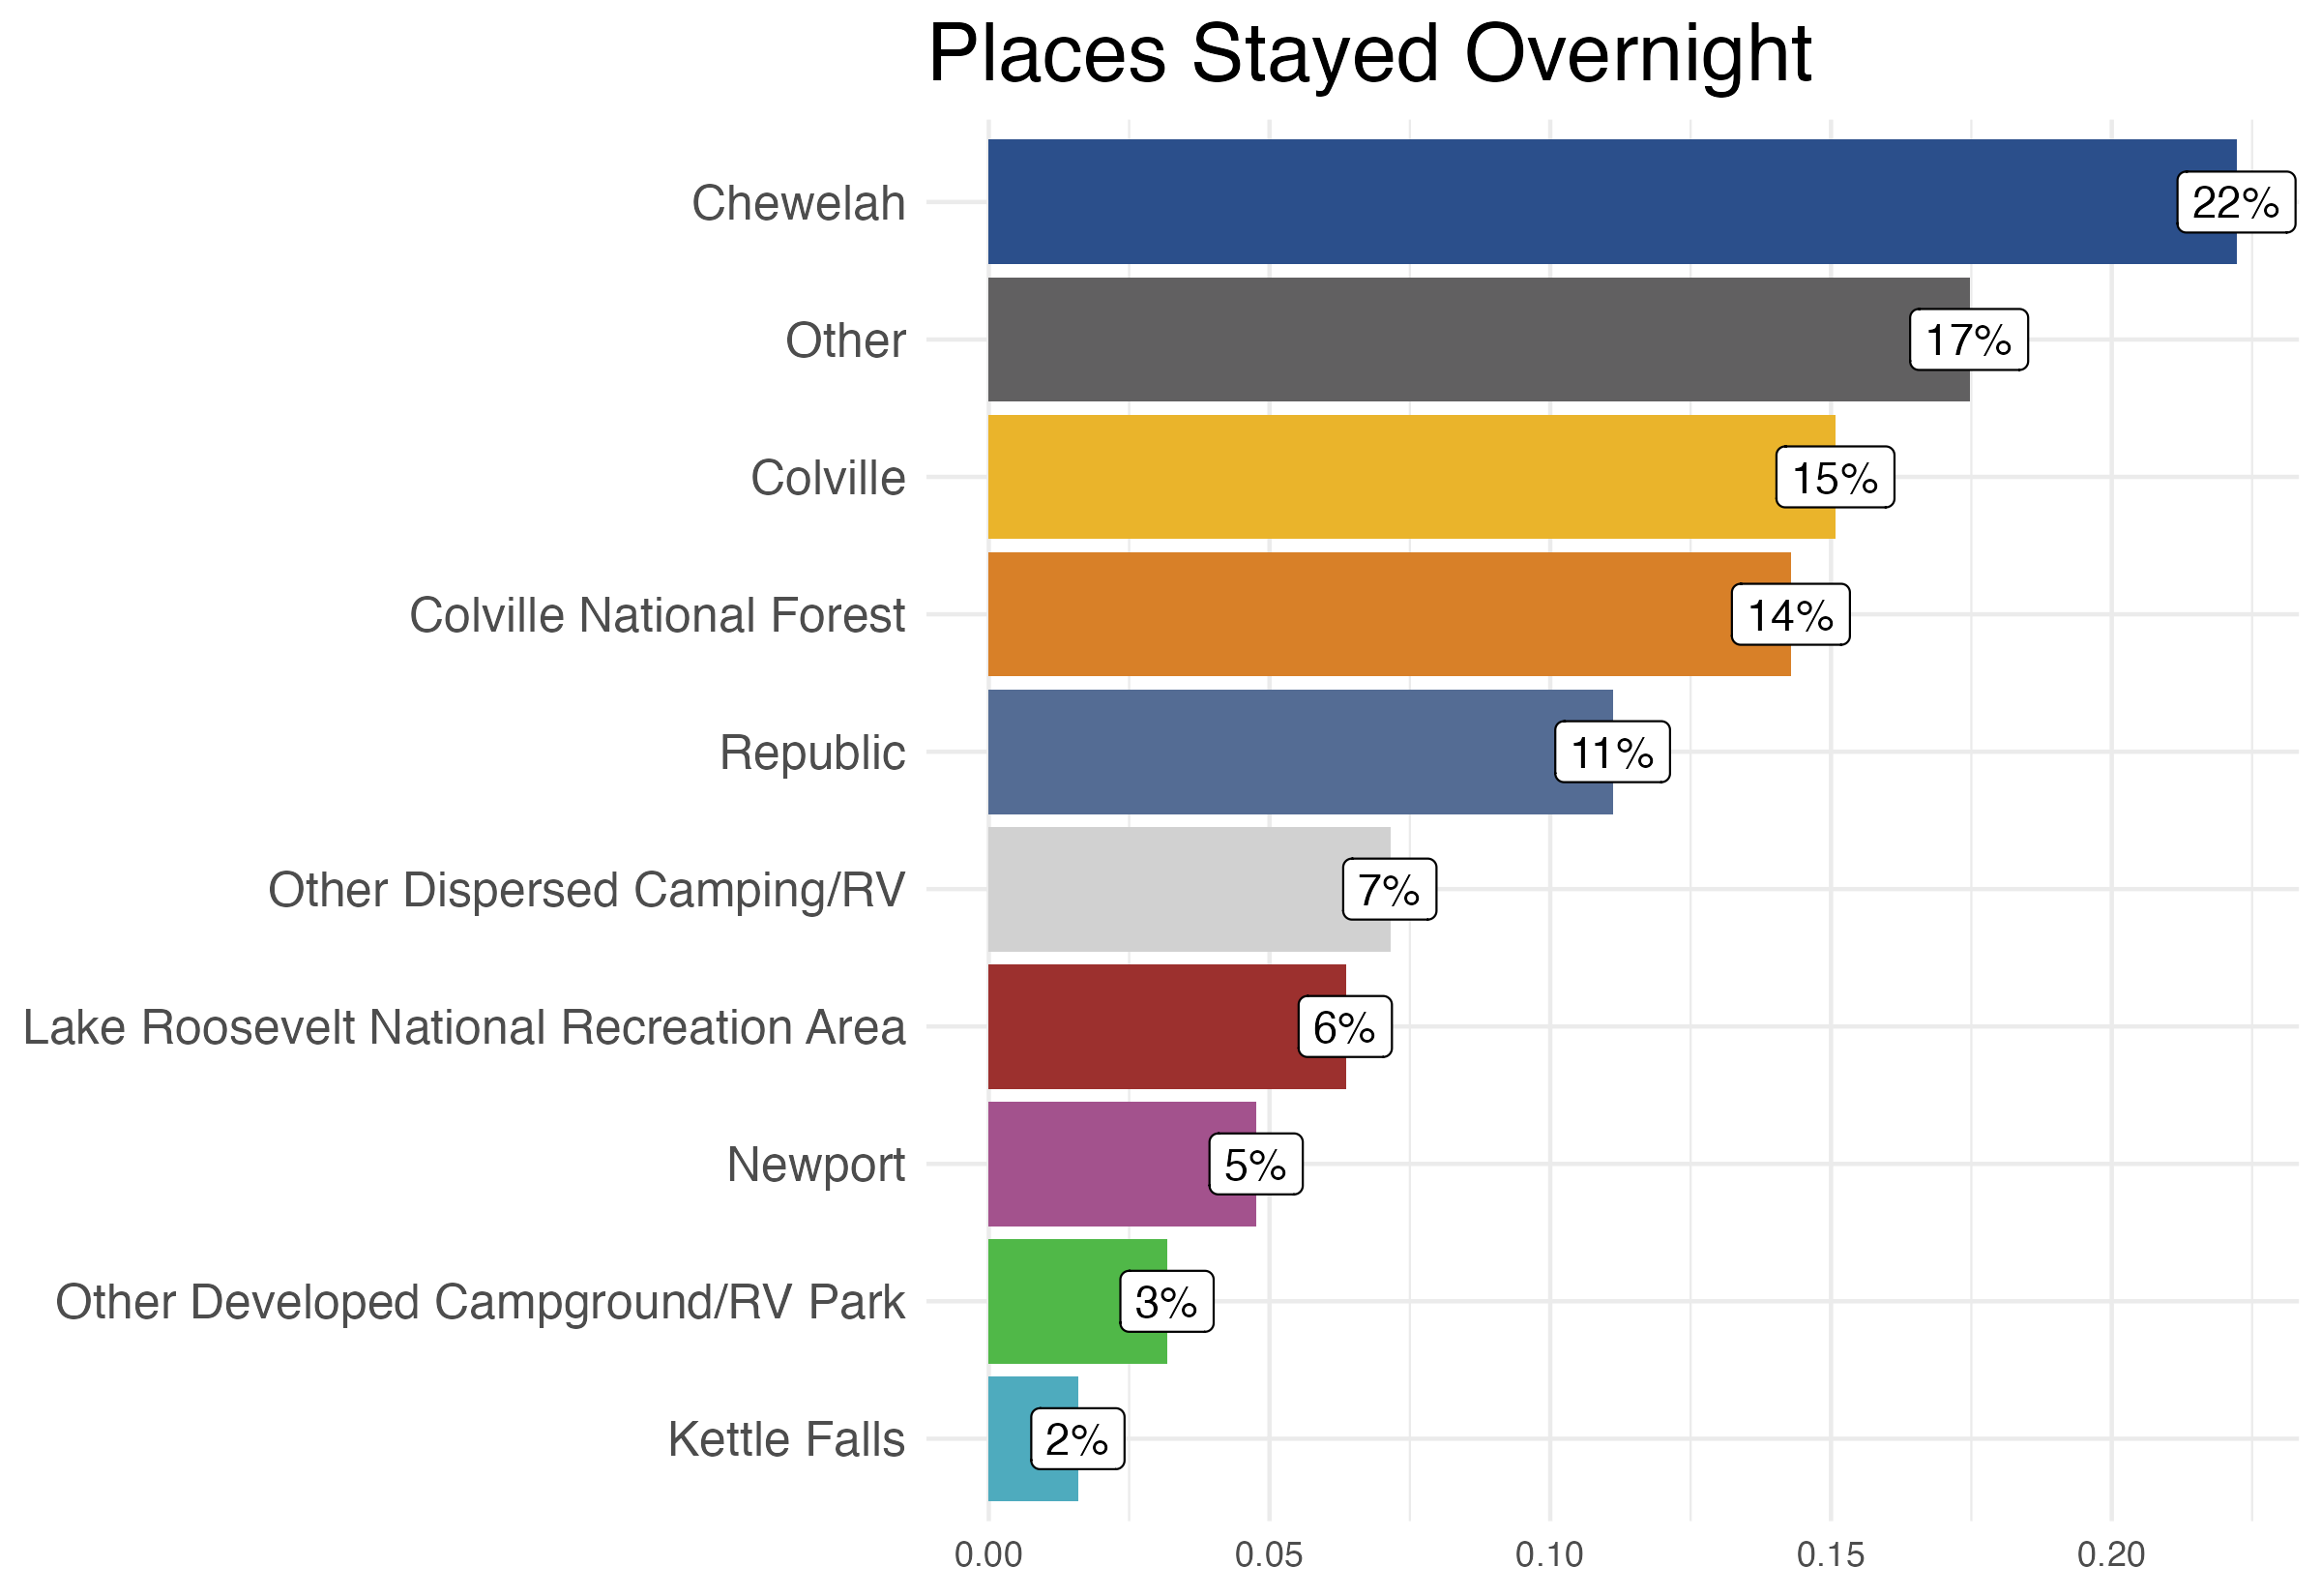
Visitor Overview
"Other" Top Responses:
Spokane, Ione, Ferry Lake, Bellevue, Skookum, Lake Pend Oreille

Slide 15
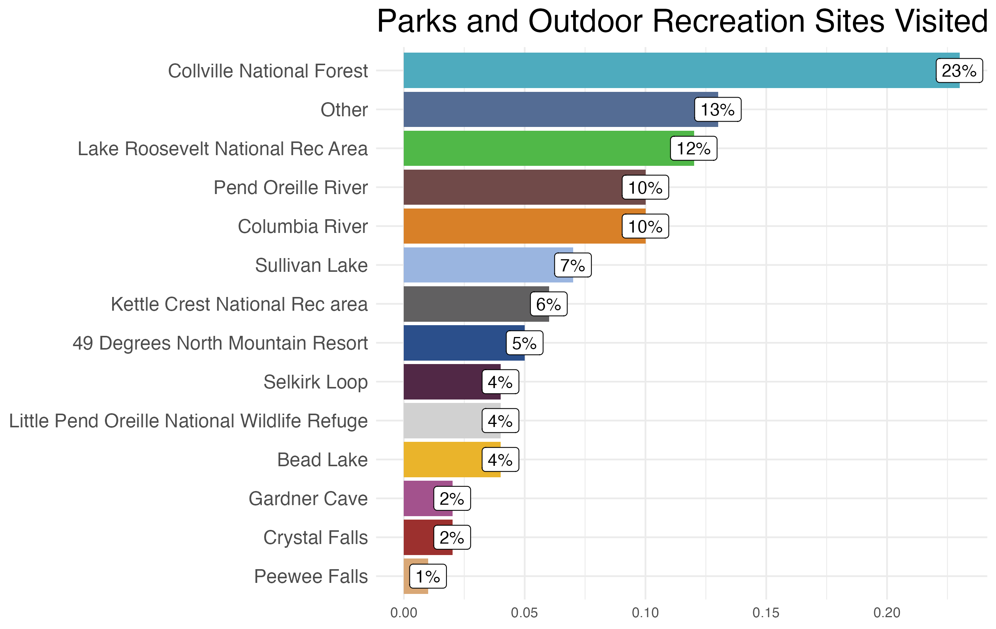
Visitor Overview
"Other" Top Responses:
Curlew Lake, Curlew, Chewelah Golf Course, Stonerose Fossil Interpretive Center
Visitors Only, n=234

Slide 16
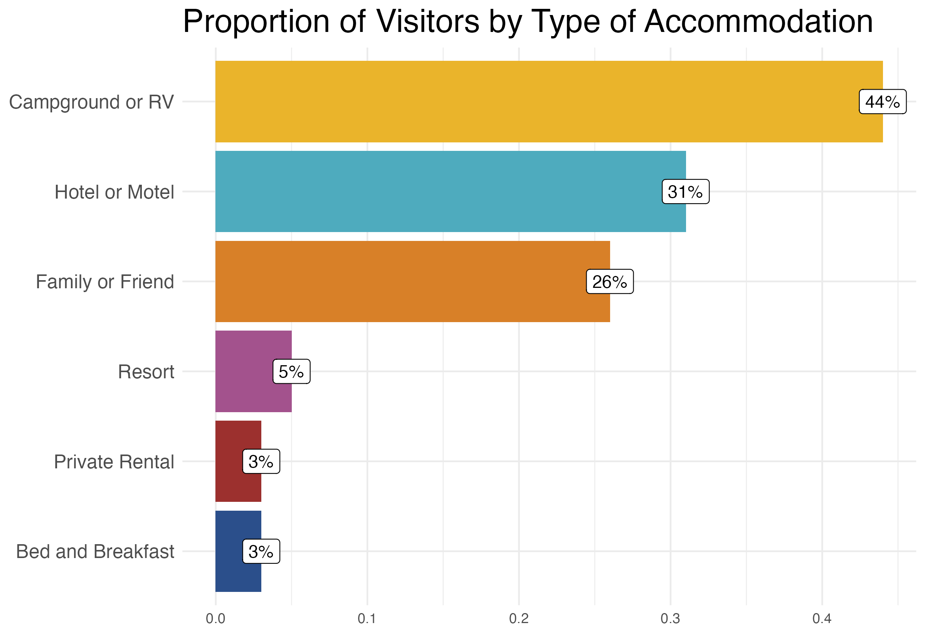
Visitor Overview

Slide 17
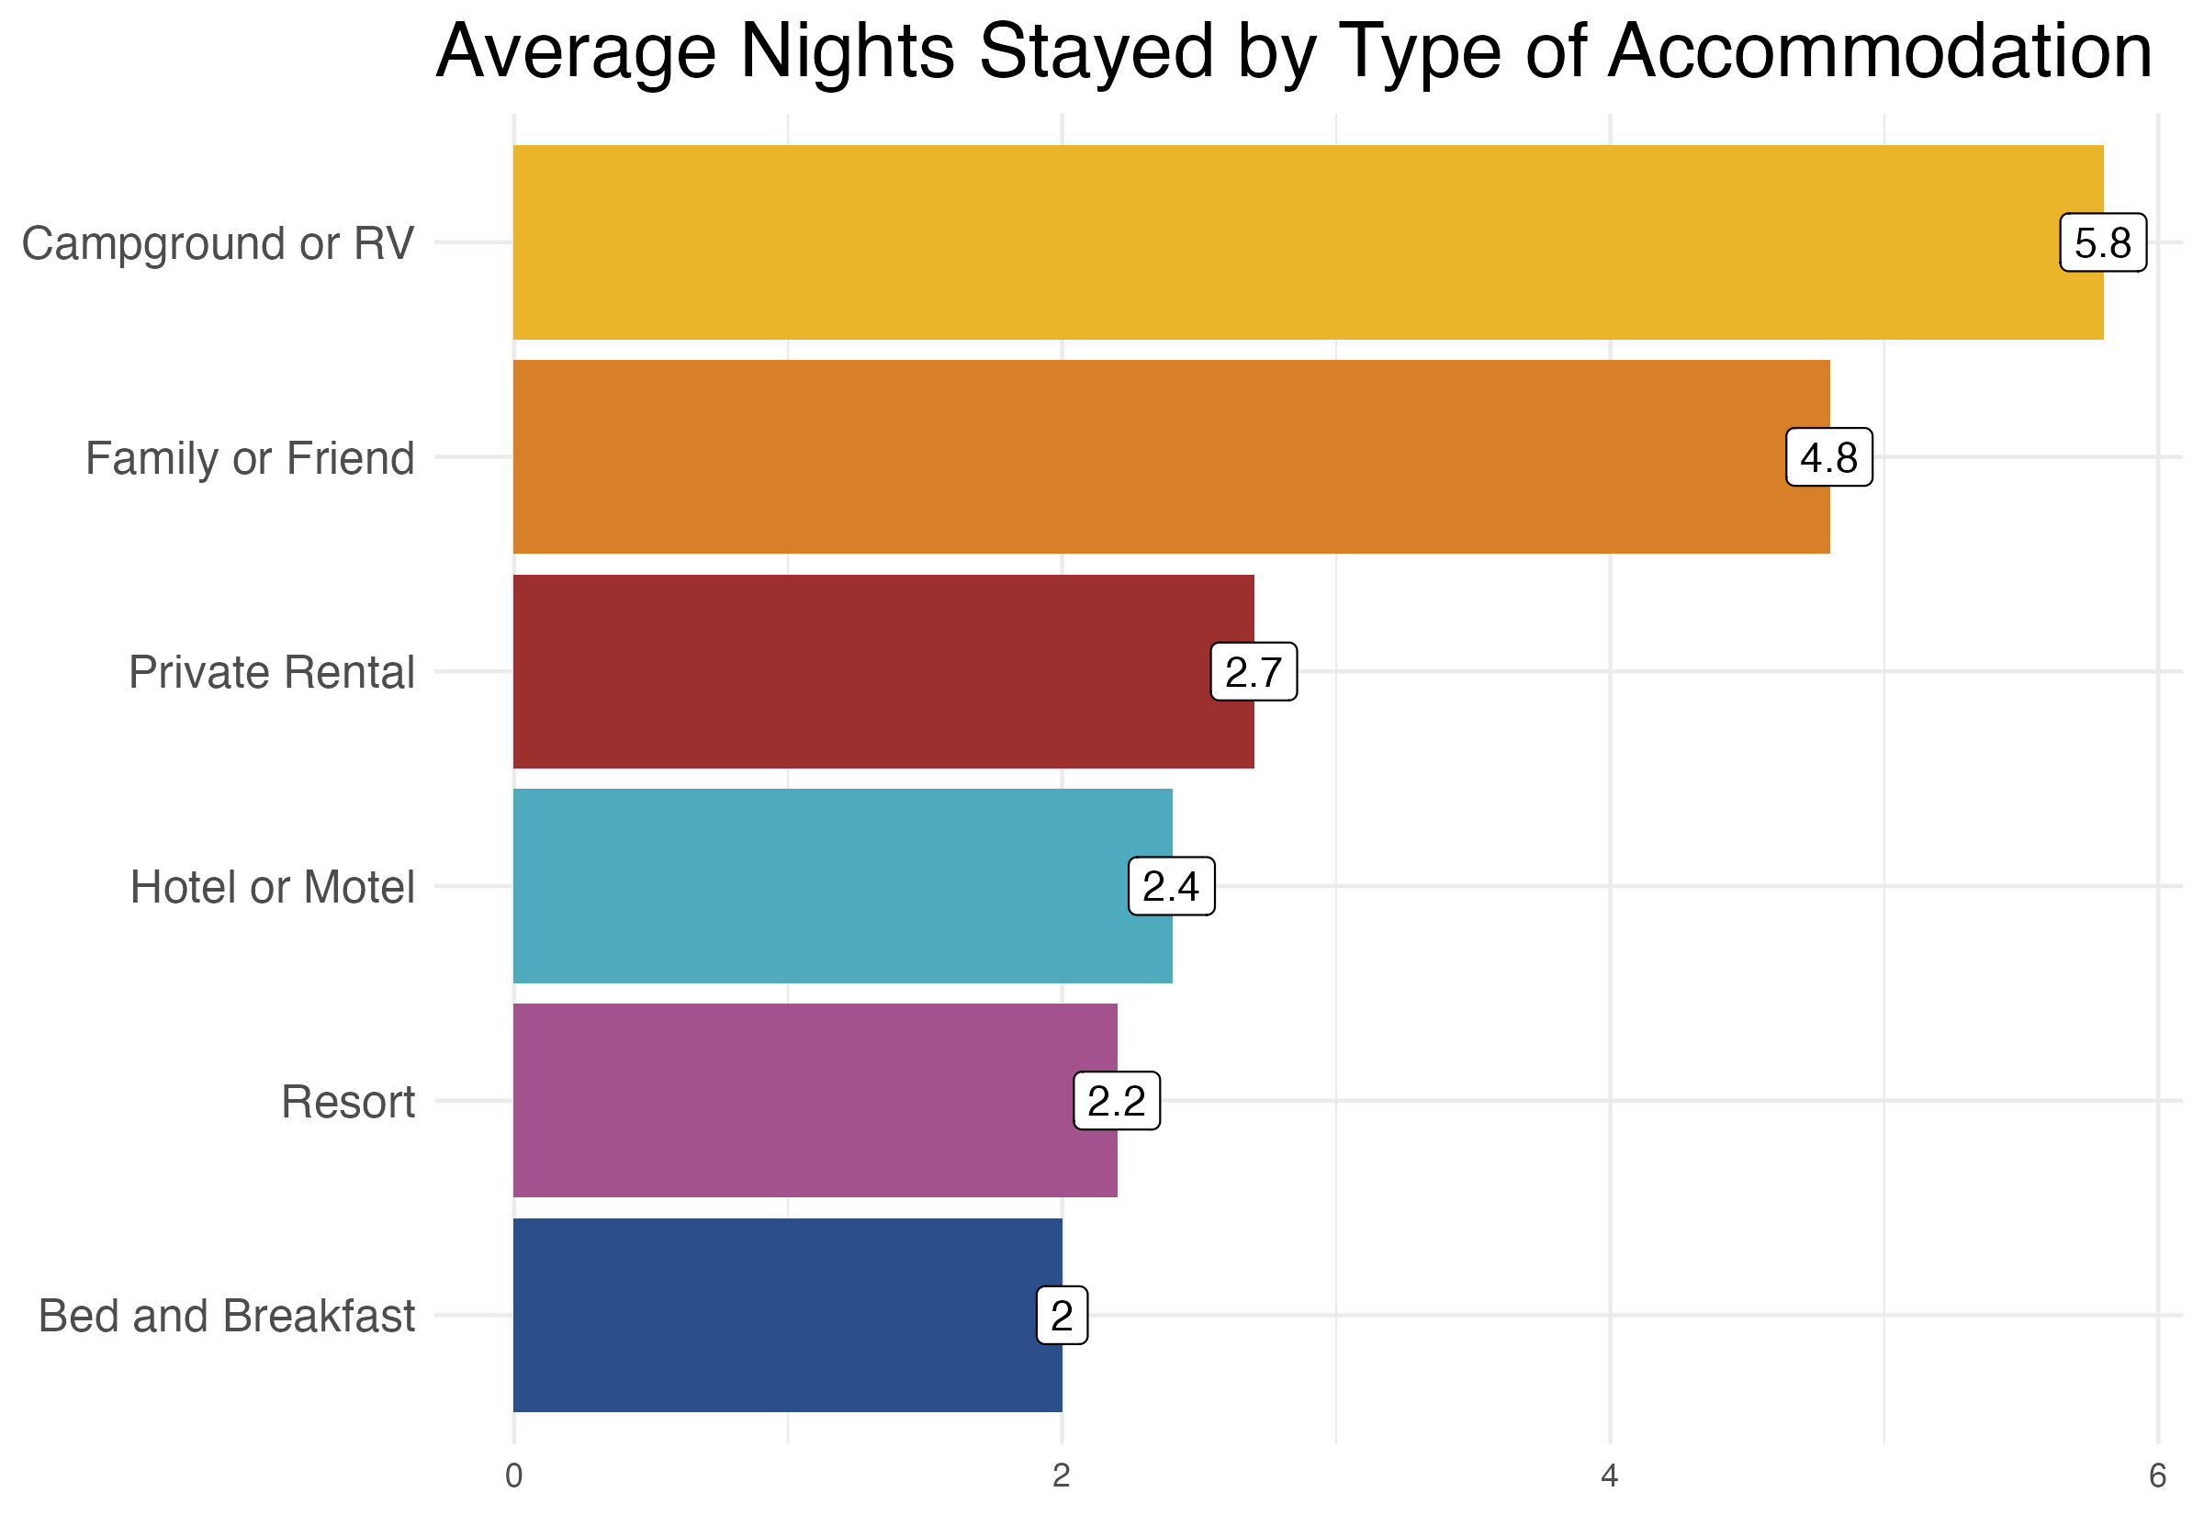
Visitor Overview

Slide 18
Differences by Visitor Demographics
Low-income visitors (less than $50,000 household income) were more likely to stay in a campground (67%) than the overall sample (44%).
Low-income visitors stayed in the Colville National Forest almost 5x more more often than all respondents (67% of low-income respondents vs. 14% for all respondents).
Low-income visitors did not travel by camper/RV (compared to 22% of higher income respondents).
(Note: statistical significance of differences across groups was not tested)
Notes:
Low-income, racial/ethnic minorities, and disabled individuals face more barriers to spending time in the outdoors than individuals in higher-income groups. As a result, we often look to see if there are meaningful differences between how these individuals recreate, whether there are specific barriers to them accessing other services, and if there are opportunities to increase access to public recreational facilities. For this survey, there was not enough information about disabilities, or respondents racial/ethnic backgrounds, so we examined the gaps only by income.

Slide 19
Section II: Visitor Activities and Satisfaction

Slide 20
Visitor Activities
Primary reasons for visiting NE Washington area:
Outdoor Rec: 32%
Golfing: 29%
Other (write in): 13%
Visiting family and friends: 9%
Golfing, hiking and eating at local restaurants are the most common activities.

Slide 21
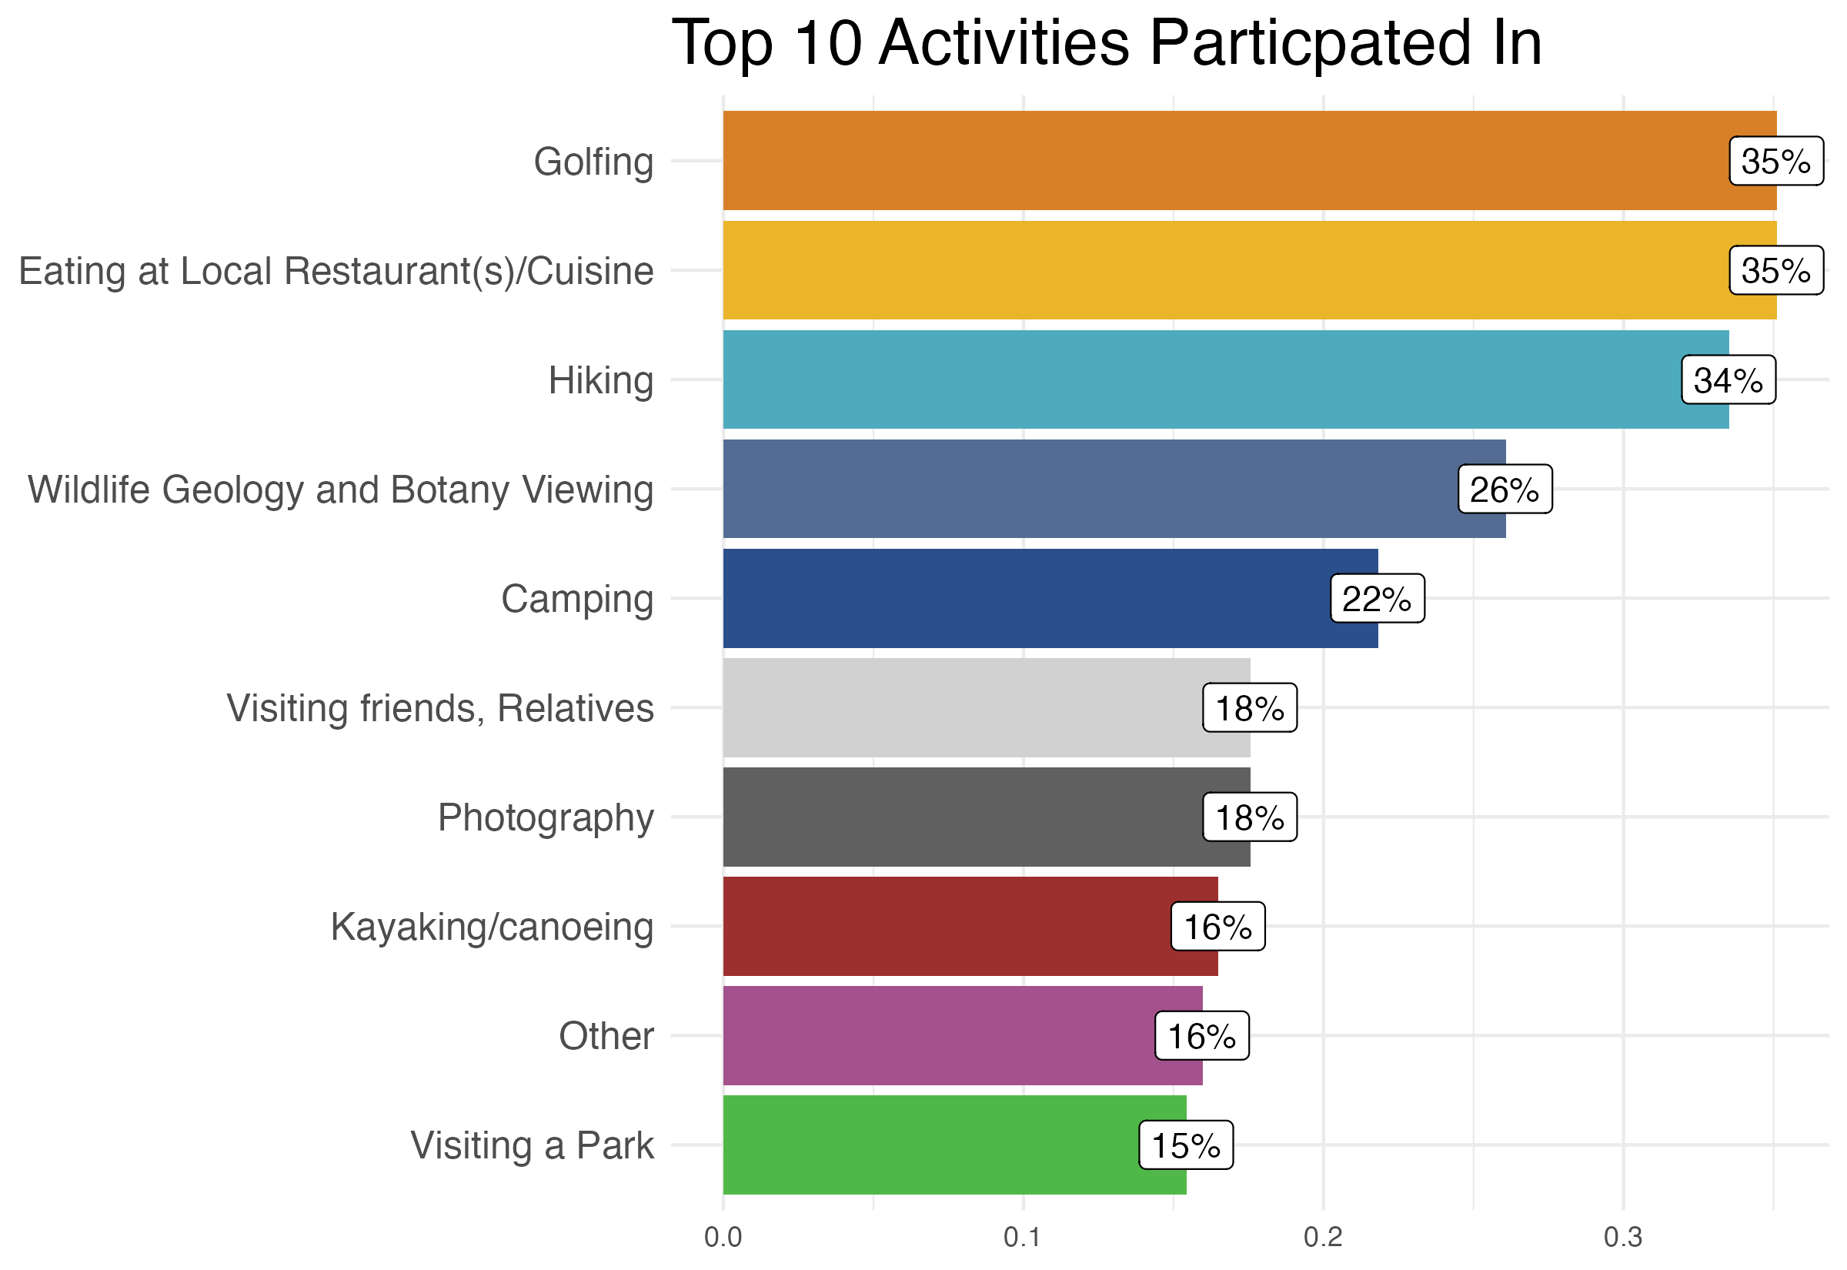
Visitor Activities

Slide 22
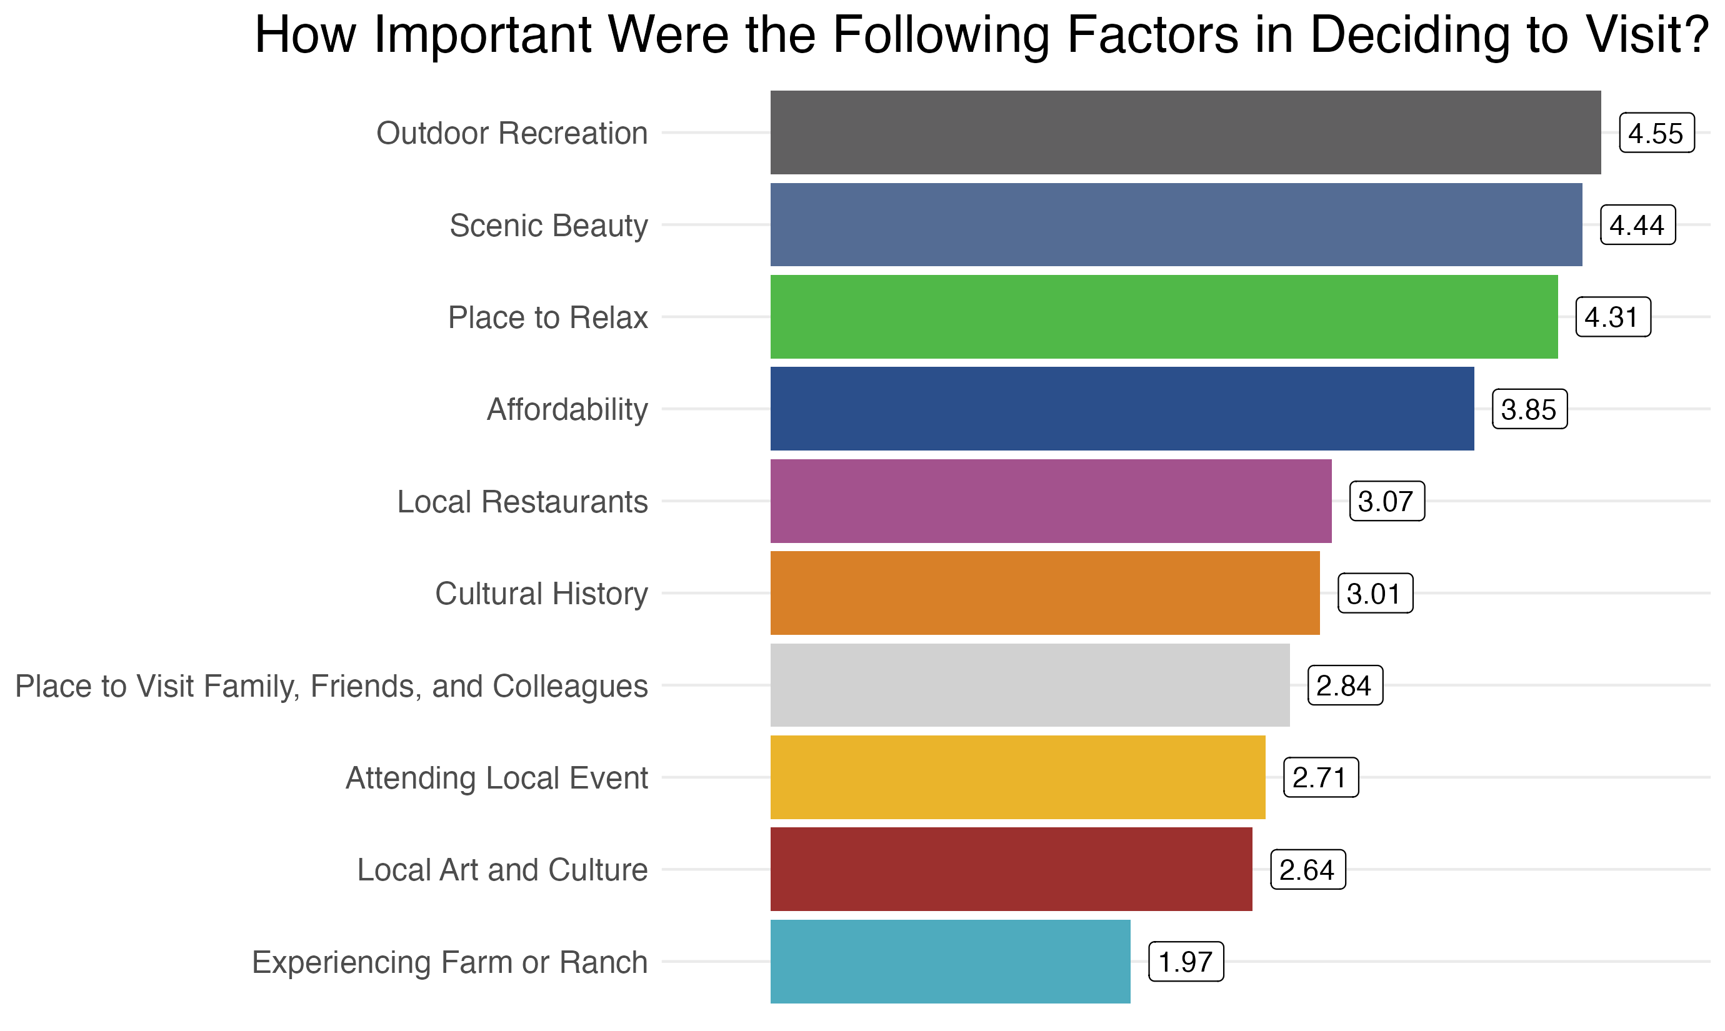
Visitor Satisfaction
Note: Scale 1 = Low, 5 = High

Slide 23
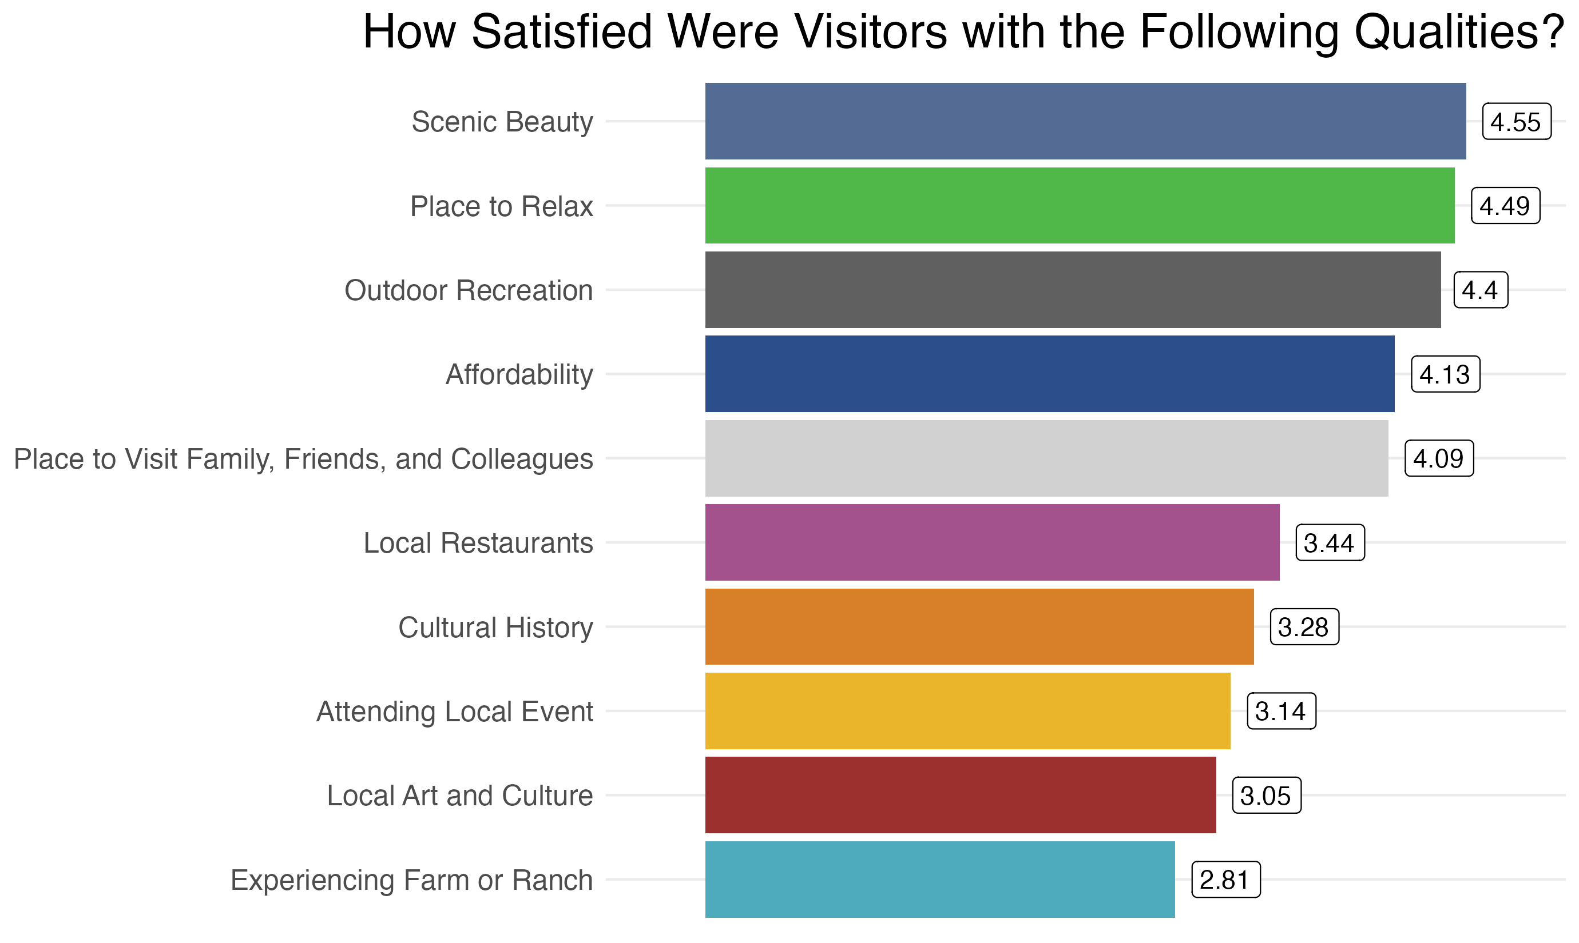
Visitor Satisfaction
Note: Scale 1 = Low, 5 = High

Slide 24
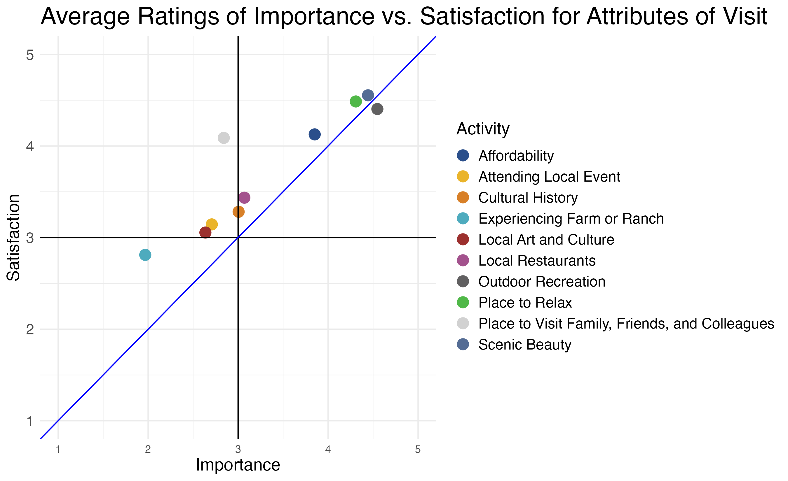
Visitor Satisfaction

Slide 25
Differences by Visitor Demographics
Types of activity participation were similar across incomes apart from golfing, where low-income visitors participated much less when compared to the whole sample.
Low-income visitors were more likely to go camping than the overall sample.
Low-income visitors responded that camping was their primary reason for visiting NE Washington over 2x as often compared to the rest of the sample (14% compared to 6%).
Low-income visitors responded that affordability and outdoor recreation were more important in their decision to travel to NE Washington.

Slide 26
Section III: Trip Planning and Future Visits

Slide 27
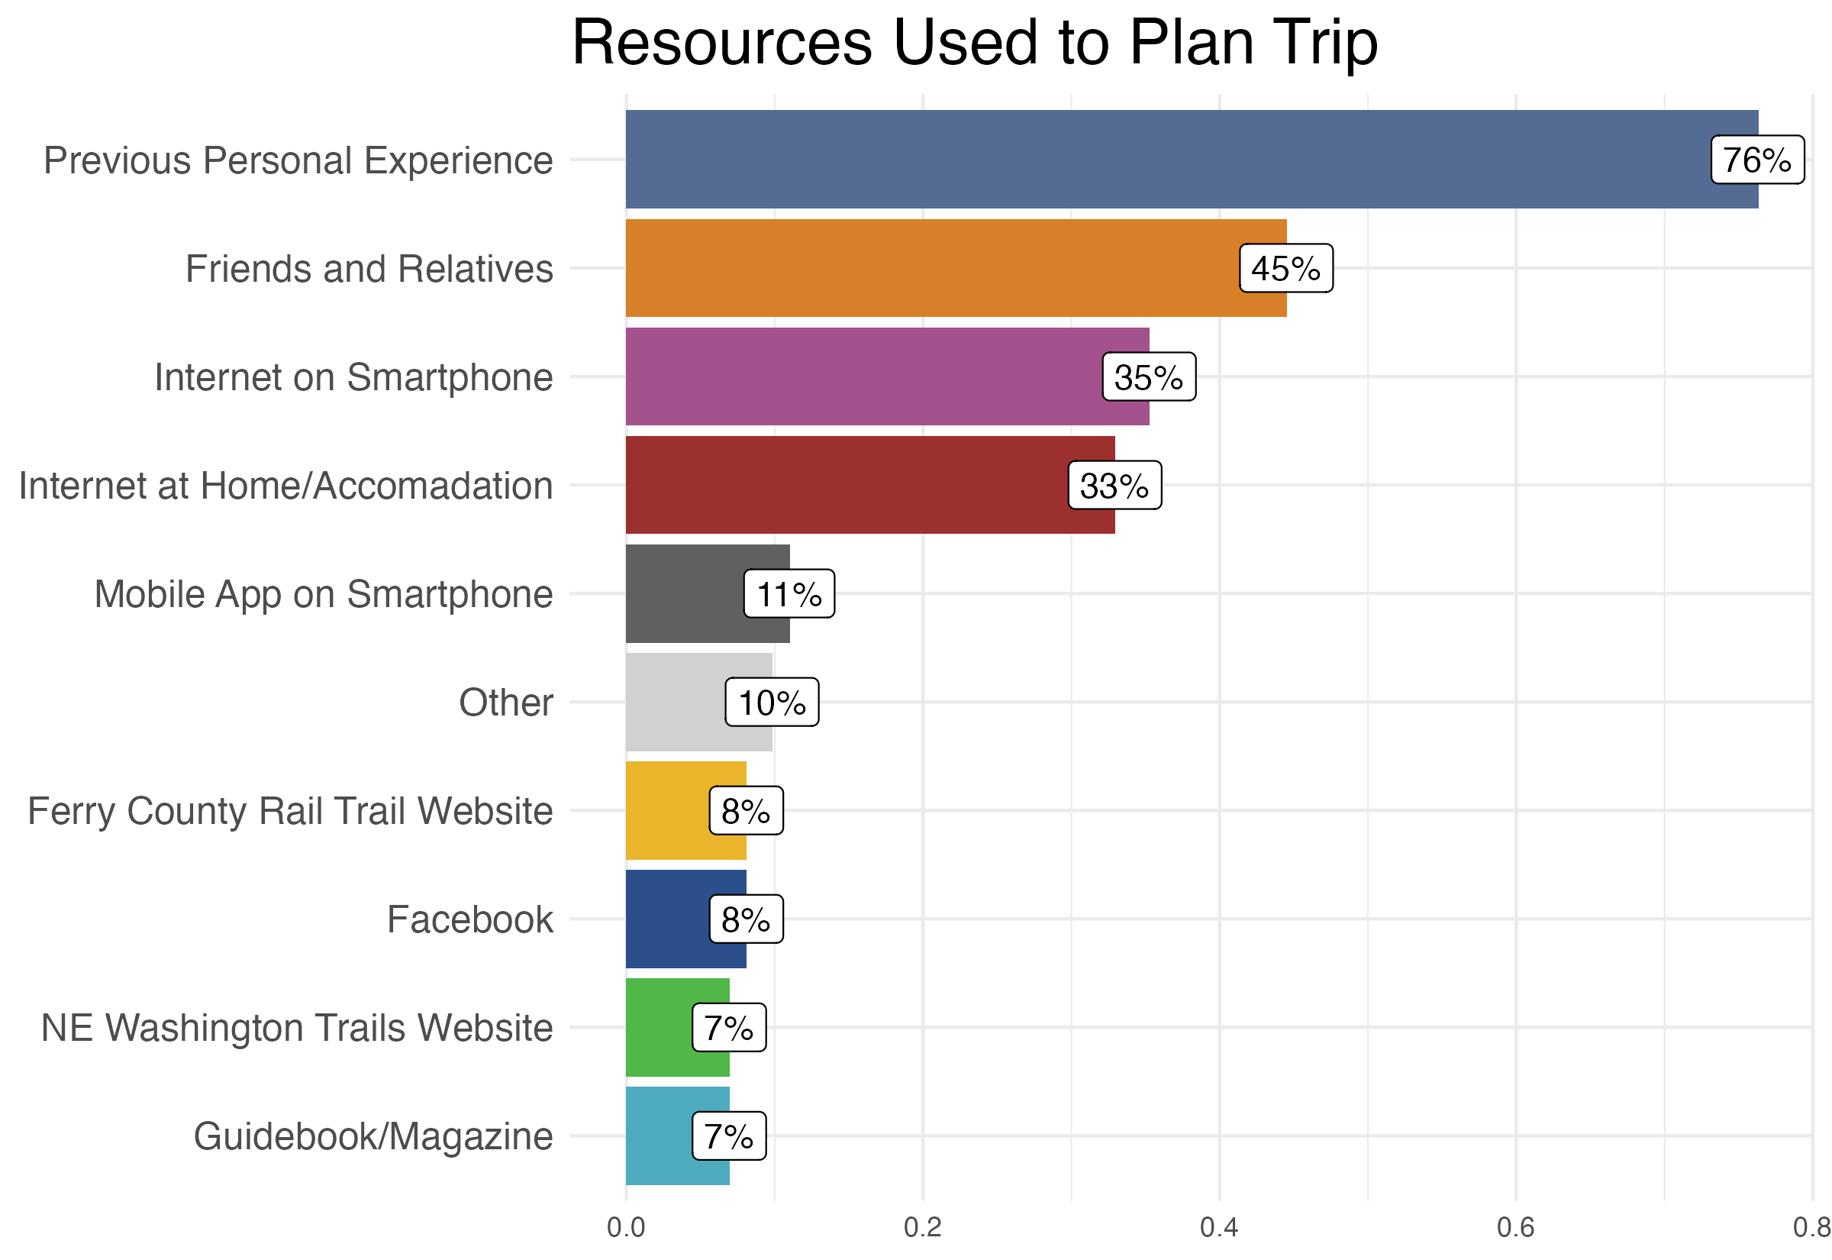
Trip Planning and Future Visits

Slide 28
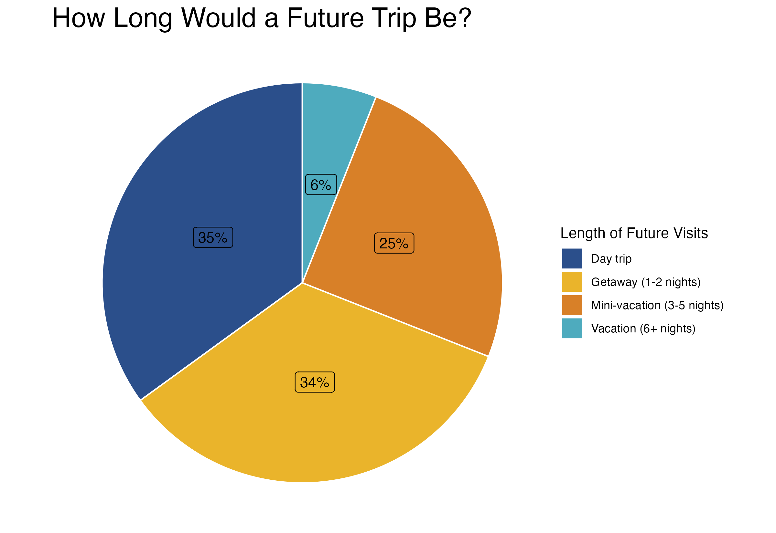
Trip Planning and Future Visits

Slide 29
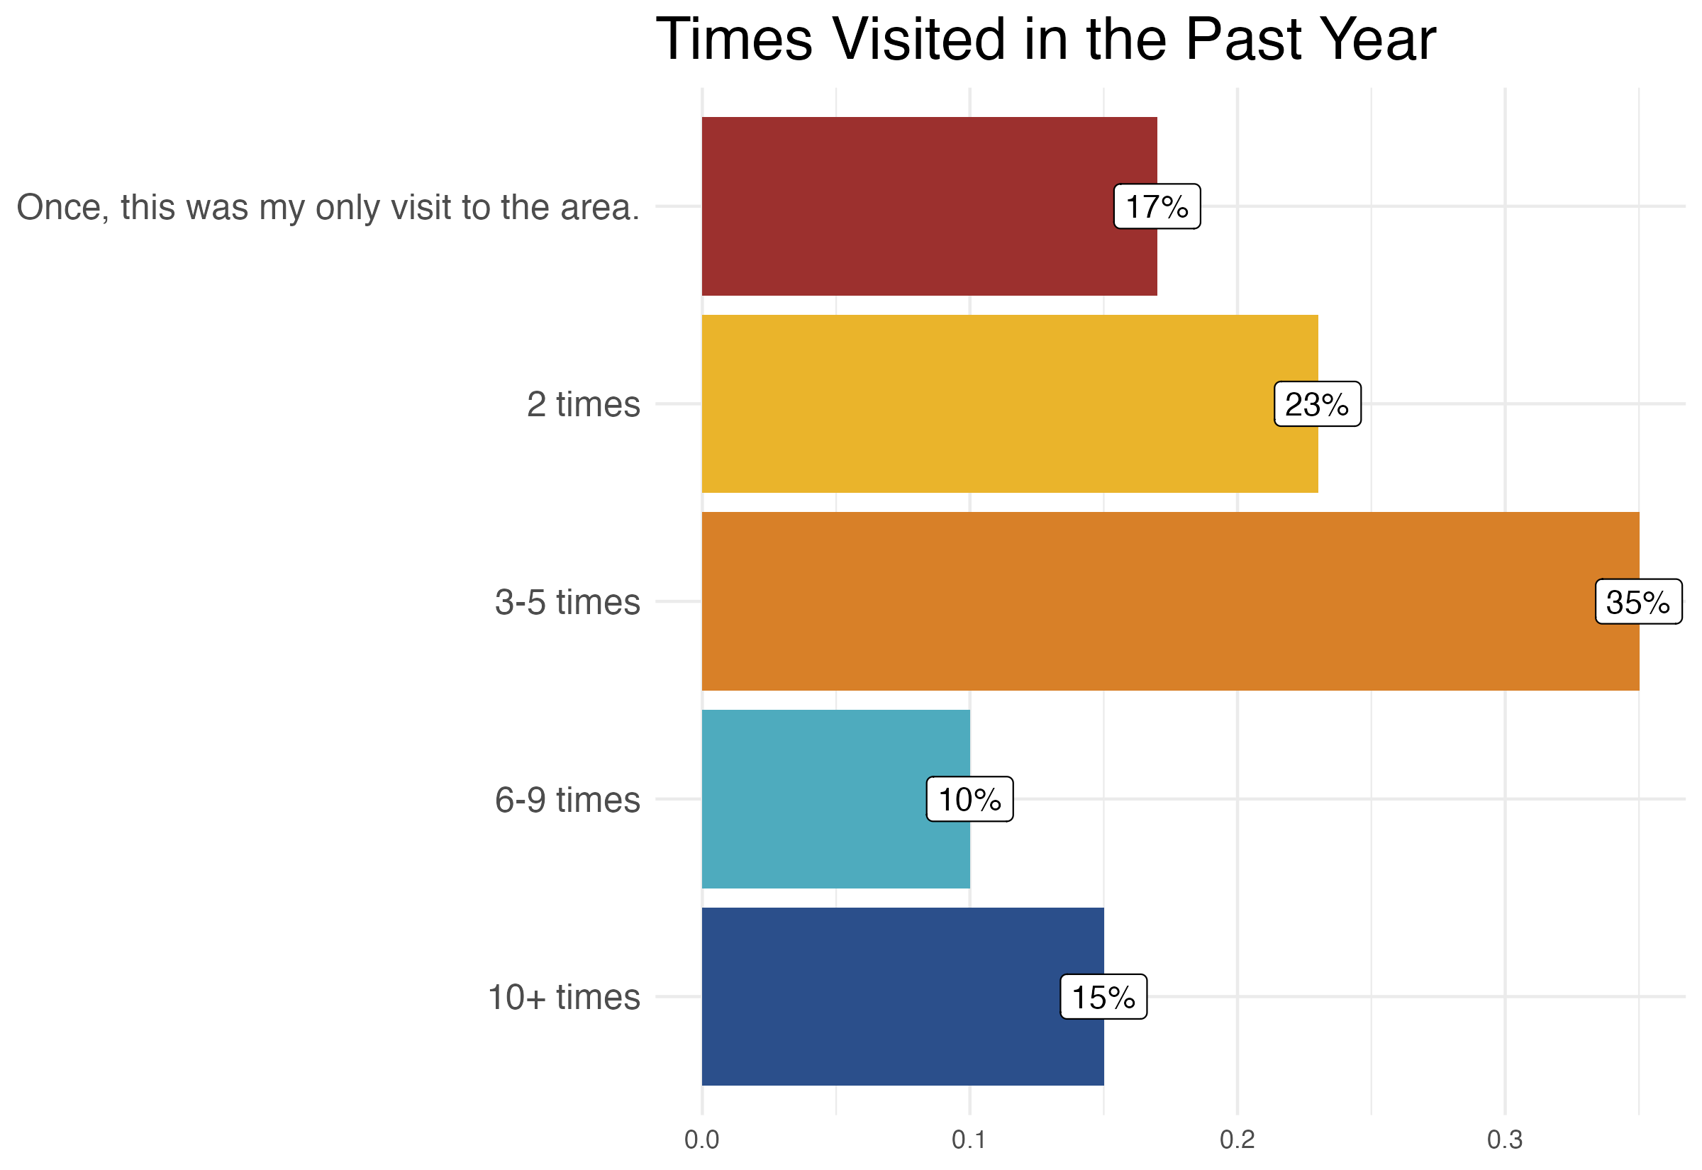
Trip Planning and Future Visits

Slide 30
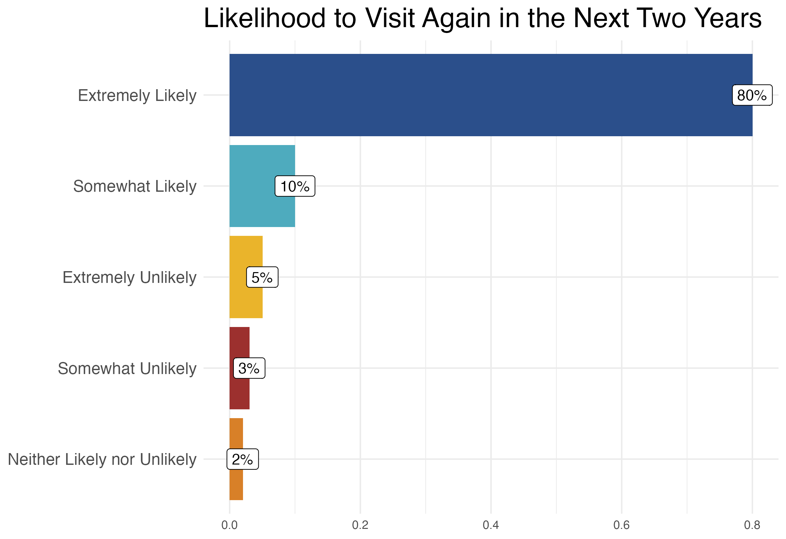
Trip Planning and Future Visits

Slide 31
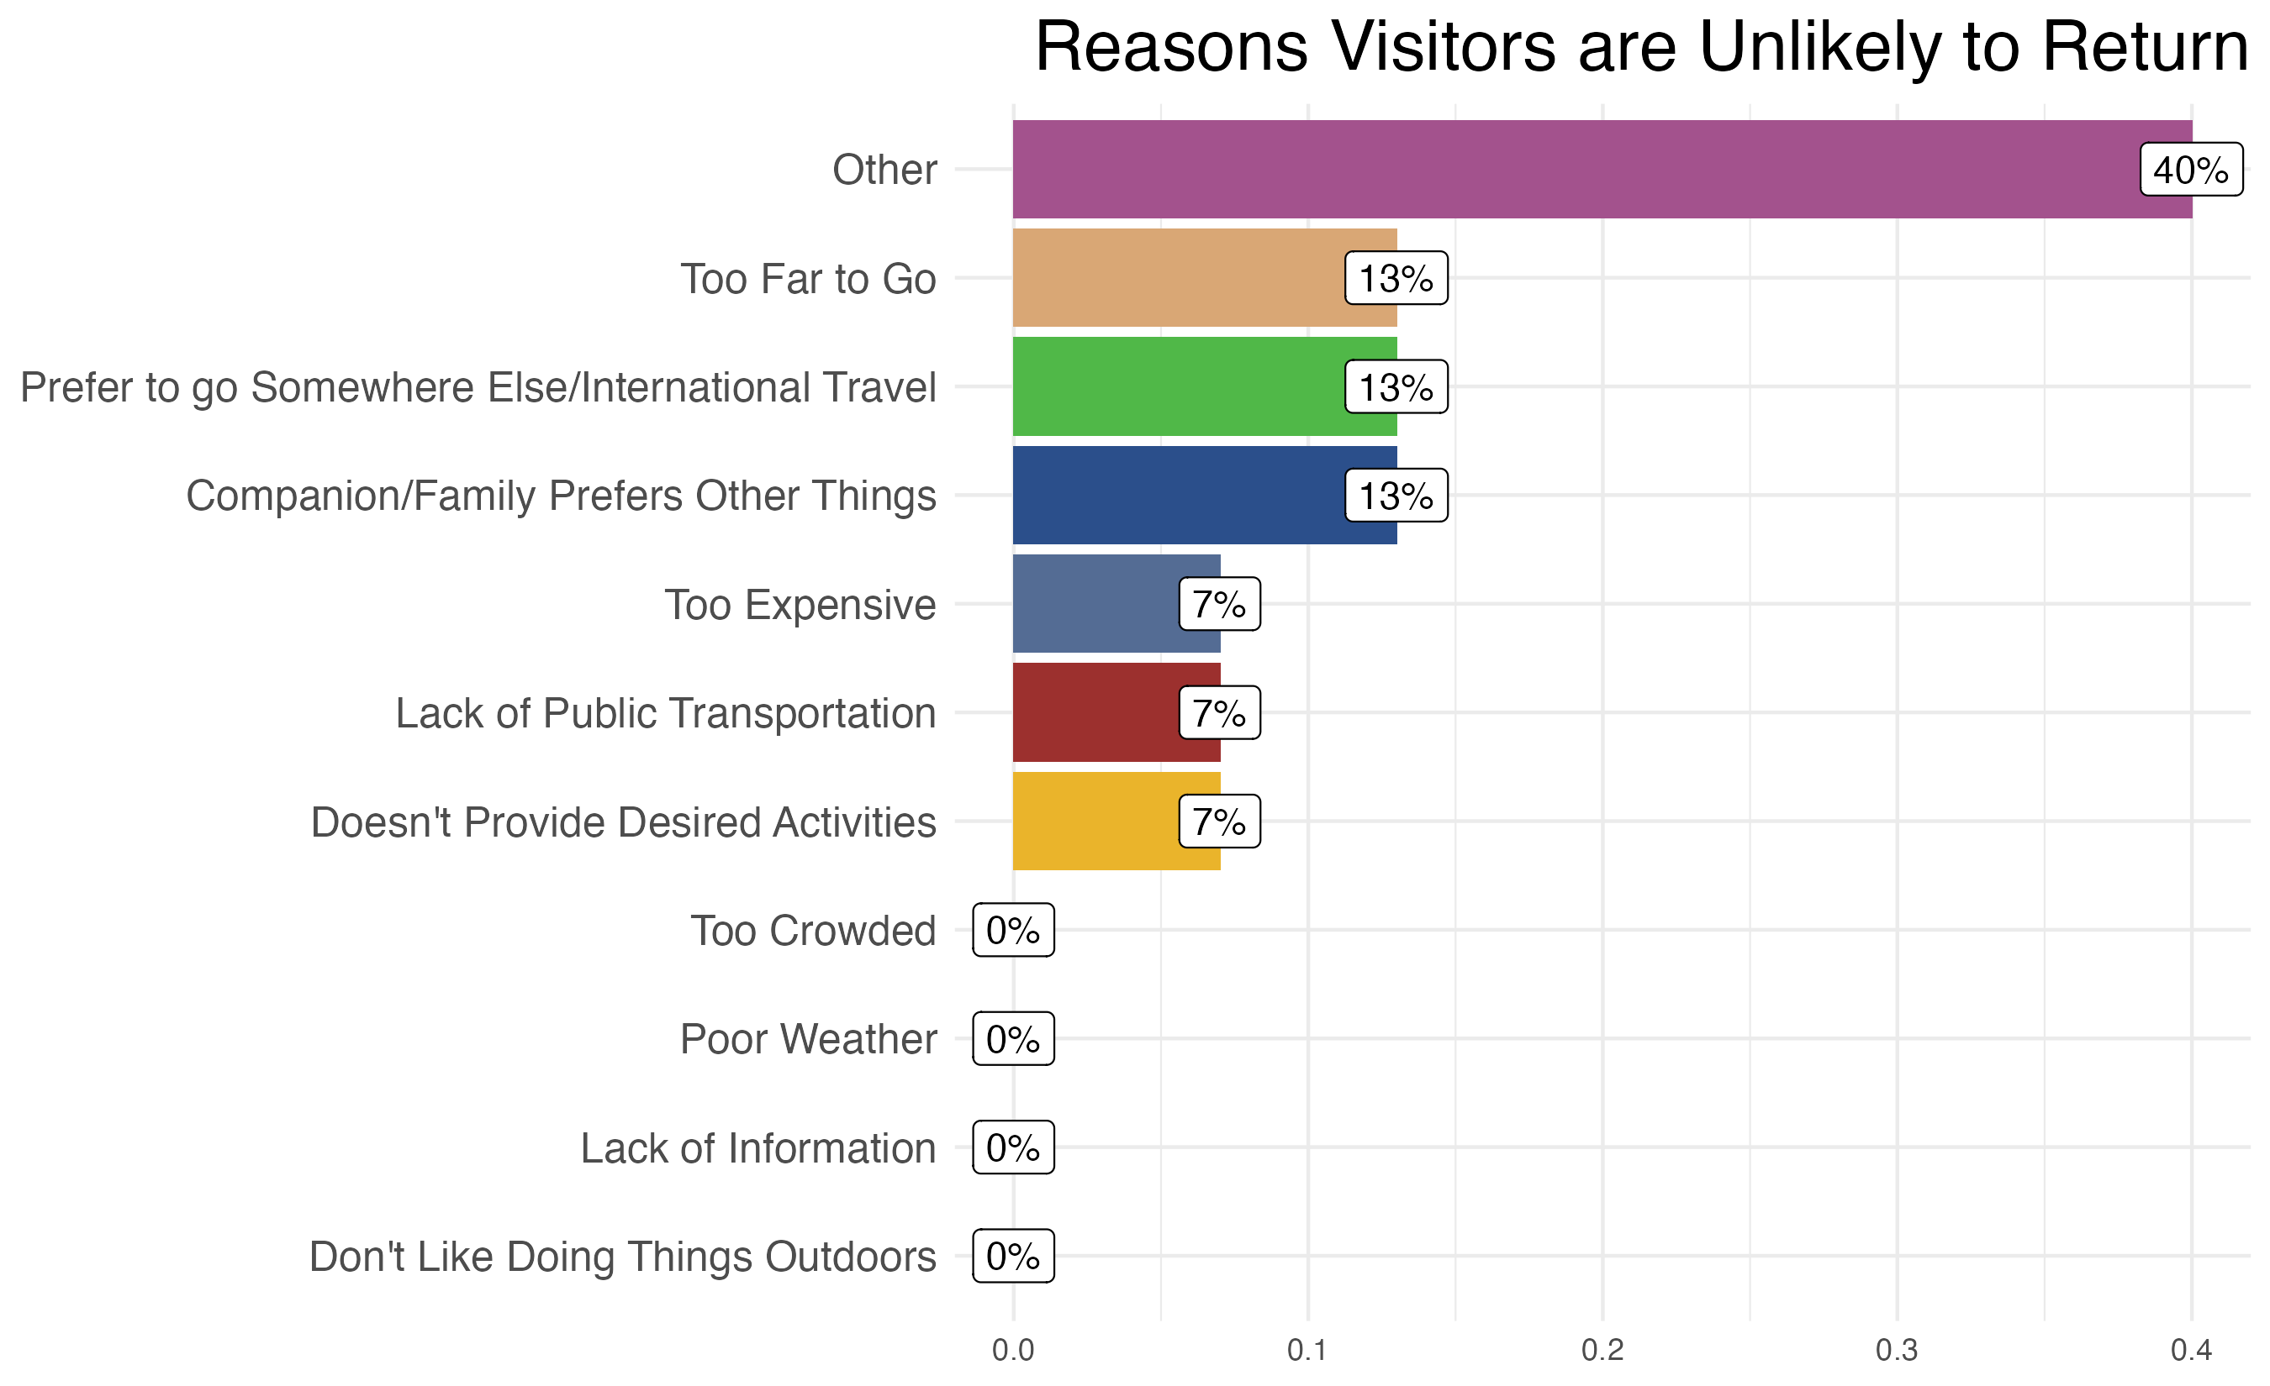
Trip Planning and Future Visits
"Other" Top Responses:
lack of COVID-19 compliance, poor customer service, lack of restaurants, politics
Only visitors who were unlikely to return, n= 81

Slide 32
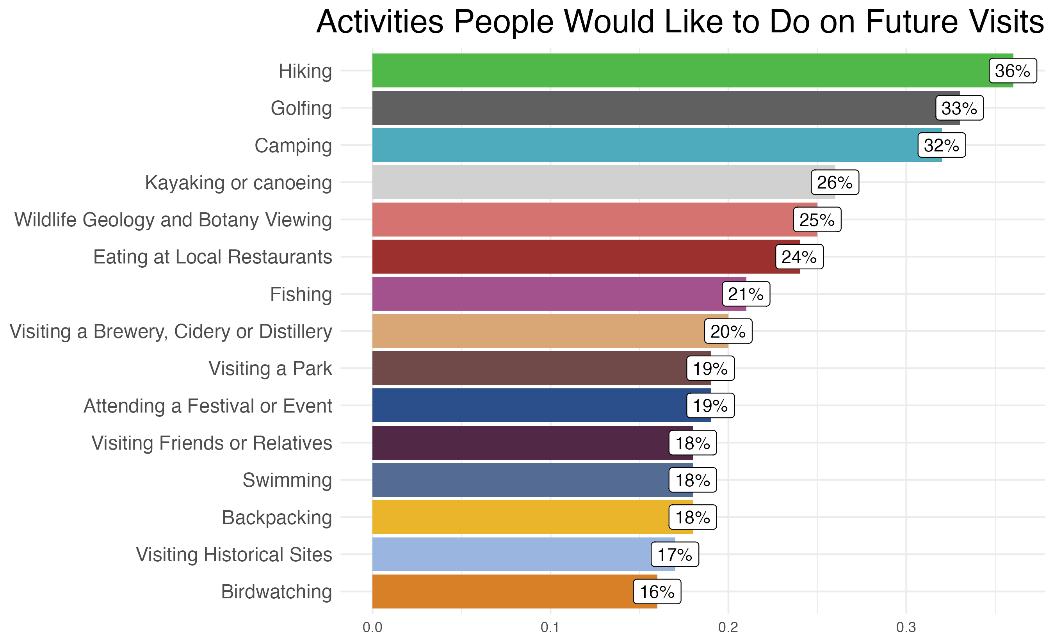
Trip Planning and Future Visits

Slide 33
Differences by Visitor Demographics
Low-income visitors were more likely to go camping, view local wildlife and botany, and attend a festival or event than the overall sample.
- Low-income visitors are less likely to want to go golfing in the future.
- Low-income visitors responded that their partner/ companion would prefer to do other things.
Low–income visitors were less likely to be “extremely likely” to visit the NE Washington area within the next two years.
(63% of low-income visitors responded, “extremely likely”, vs. 80% of all respondents and 81% of higher-income respondents)

Slide 34
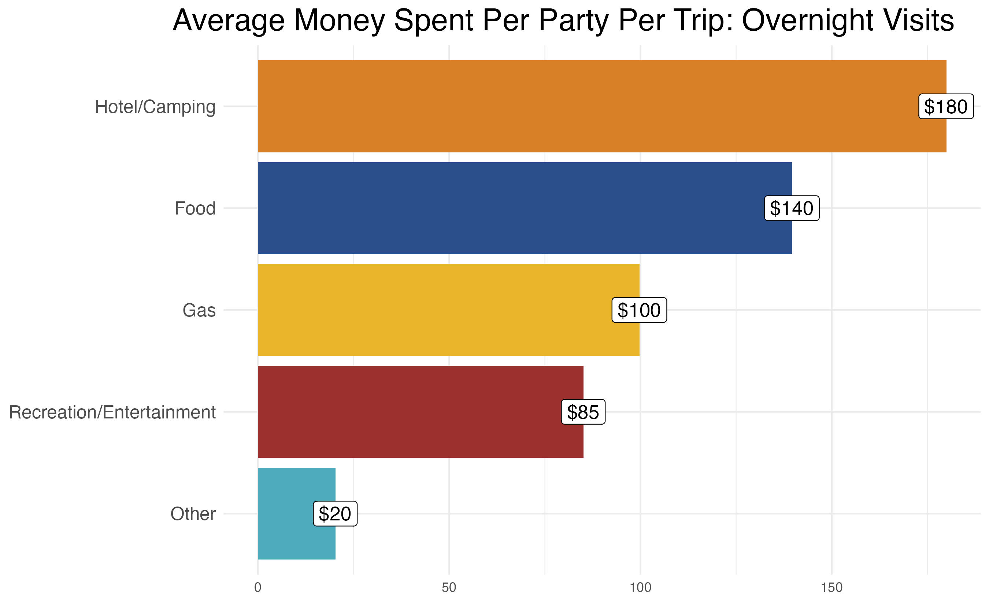
Economic Impact
Overnight visitors only, n = 226

Slide 35
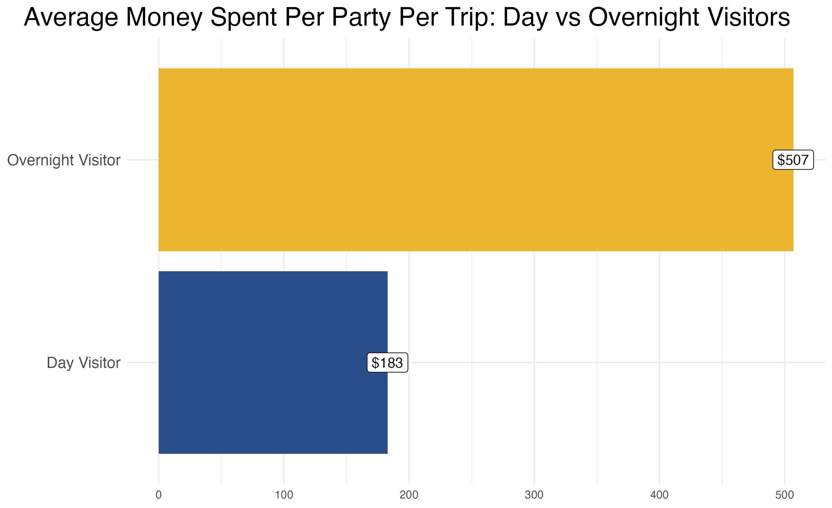
Economic Impact

Slide 36
Economic Impact
Day Trips: Average spending per party per day: $183
Overnight Trips: Average spending per party per night: $102
Visitors staying in lodging (hotels, resorts, or vacation rentals) spend about $222 more per trip than visitors staying with friends and family or camping.

Slide 37
Section IV: Written Feedback

Slide 38
Written Feedback
Visitors Liked
Outdoor Recreation
Affordability
Natural beauty
Relaxation
Golfing
Visitors Disliked
Lack of availability of accommodations
Trail conditions and lack of maintenance
Situational - COVID-19 and wildfires
Restaurants, bars and dining
Politics
Based on most frequent themes in text analysis of written responses

Slide 39
Quotes: Top 3 Things Visitors Enjoyed
That we didn't see anyone else on our snowshoe! The Mexican Restaurant and the Cool little store in town.
Scenery, Watersports, Friends/Family.
Scenic beauty, outdoor recreation, affordability.
Sharing the scenery with friends when skiing at 49 and flying hang gliders. We get to fly with Golden Eagles at Inklers Point :) --- hard to beat getting to fly with eagles!
Solitude, scenic beauty, ability to do multiple outdoor activities in one trip (stand up paddleboarding and hiking).
The mountains, the scenery and the people.
Natural beauty of forest and mountains and rural life, peace of being immersed in the natural world.
Golf course, meeting friends, eating at local establishments.

Slide 40
Quotes: Difficulties Visitors Faced
Hard to find a place to eat and extremely long wait when we did.
Some limited restaurant access due to low staffing.
Difficult to find places to eat, but it worked out fine.
Not negative per se, but the boat ramp experience at Bead Lake was a bit more difficult than at other lakes--with the ability to only unload one car at a time and having to do it quickly while others are waiting.
The people aren't very nice. They are kind of salty about non-locals being around. Preponderance of conservative flags made us feel unsafe.
Lack of eating options in Colville.
Launch areas on Steptoe for hang gliders and paraglides are not ameliorated. It would be safer to have some designated launch sites.

Slide 41
Quotes: Improvements Visitors Want
More and better lodging.
Would love to see an amazing coffee shop that is still open in the afternoon! Parents need caffeine all day, esp. after outdoor activities with a drive back to Spokane.
A more comprehensive brochure that lists the tour options available and annual events. I've been going every year for 20 years and I still discover new tours or areas to explore, local events, etc. But it is most important to me that the area doesn't become commercialized.
I would like to know if there are places I can rent kayaks, paddle boards, mountain bikes, and whether there are locations for new users to learn and practice these activities. I also would like to know which trails are recommended for day hikes-- for easy to moderate ability, or if what level of challenge a hike may be for a middle-aged person.
More kid activities.
More OHV trails. Open forest roads to all vehicle. I love that Ferry County has signs saying speed limits are 35 when WATVs are present.

Slide 43
Extra Slides: Demographics

Slide 44
Demographics
Gender: 66 percent male
Age: 72 percent aged 41 and over
Income: 52 percent made over $75,000
Gender | Percent
Male | 66%
Female | 30%
Non-Binary | 1%
Other/Prefer not to Answer | 2%
Ages | Percent
Under 20 | 11%
21-30 | 4%
31-40 | 12%
41-50 | 21%
51-60 | 16%
61+ | 35%
Income | Percent
$150,000+ | 13%
$100,000-$149,999 | 20%
$75,000-$99,999 | 19%
$50,000-$74,999 | 26%
$20,000-$49,999 | 10%
Less than $20,000 | 3%

Slide 45
Demographics
Household Status: 44 percent households with adult kids
Race: 94 percent white
Ethnicity: 97 percent not Hispanic/Latino
Household Status | Percent
Single, no children | 16%
Household (couple, no children) | 29%
Household (single or couple) w/children living at home | 19%
Household (single or couple) w/grown children not at home | 36%
Race | Percent
﻿Native American or Alaska Native | <1%
Write In | 2%
﻿Two or more races | 2%
﻿White/Caucasian | 88%
Hispanic/Latino | Percent
Not Hispanic/Latino | 96%
Hispanic/Latino | 4%

